Slide 1


Proposers Brokerage Day 11th September 2025, Aveiro, Portugal
Mobility Management
i2D - intelligence to Drive and Move
uvolution
Uvolution Green Ltd
Miguel Aires

Slide 2
uvolution
Mobility Management
Opportunities | Challenges
On the last decade EU failed ALL Road Transport GOALS
Teaser
On the next decade
Mobility Management of Connected
Vehicles and People
can reduce
External Costs of Road Transport by
15% in Environmental
35% in Accidents
10% in Congestion
IMPACTS
Sep 2025
2

Slide 3
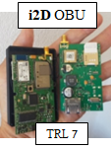
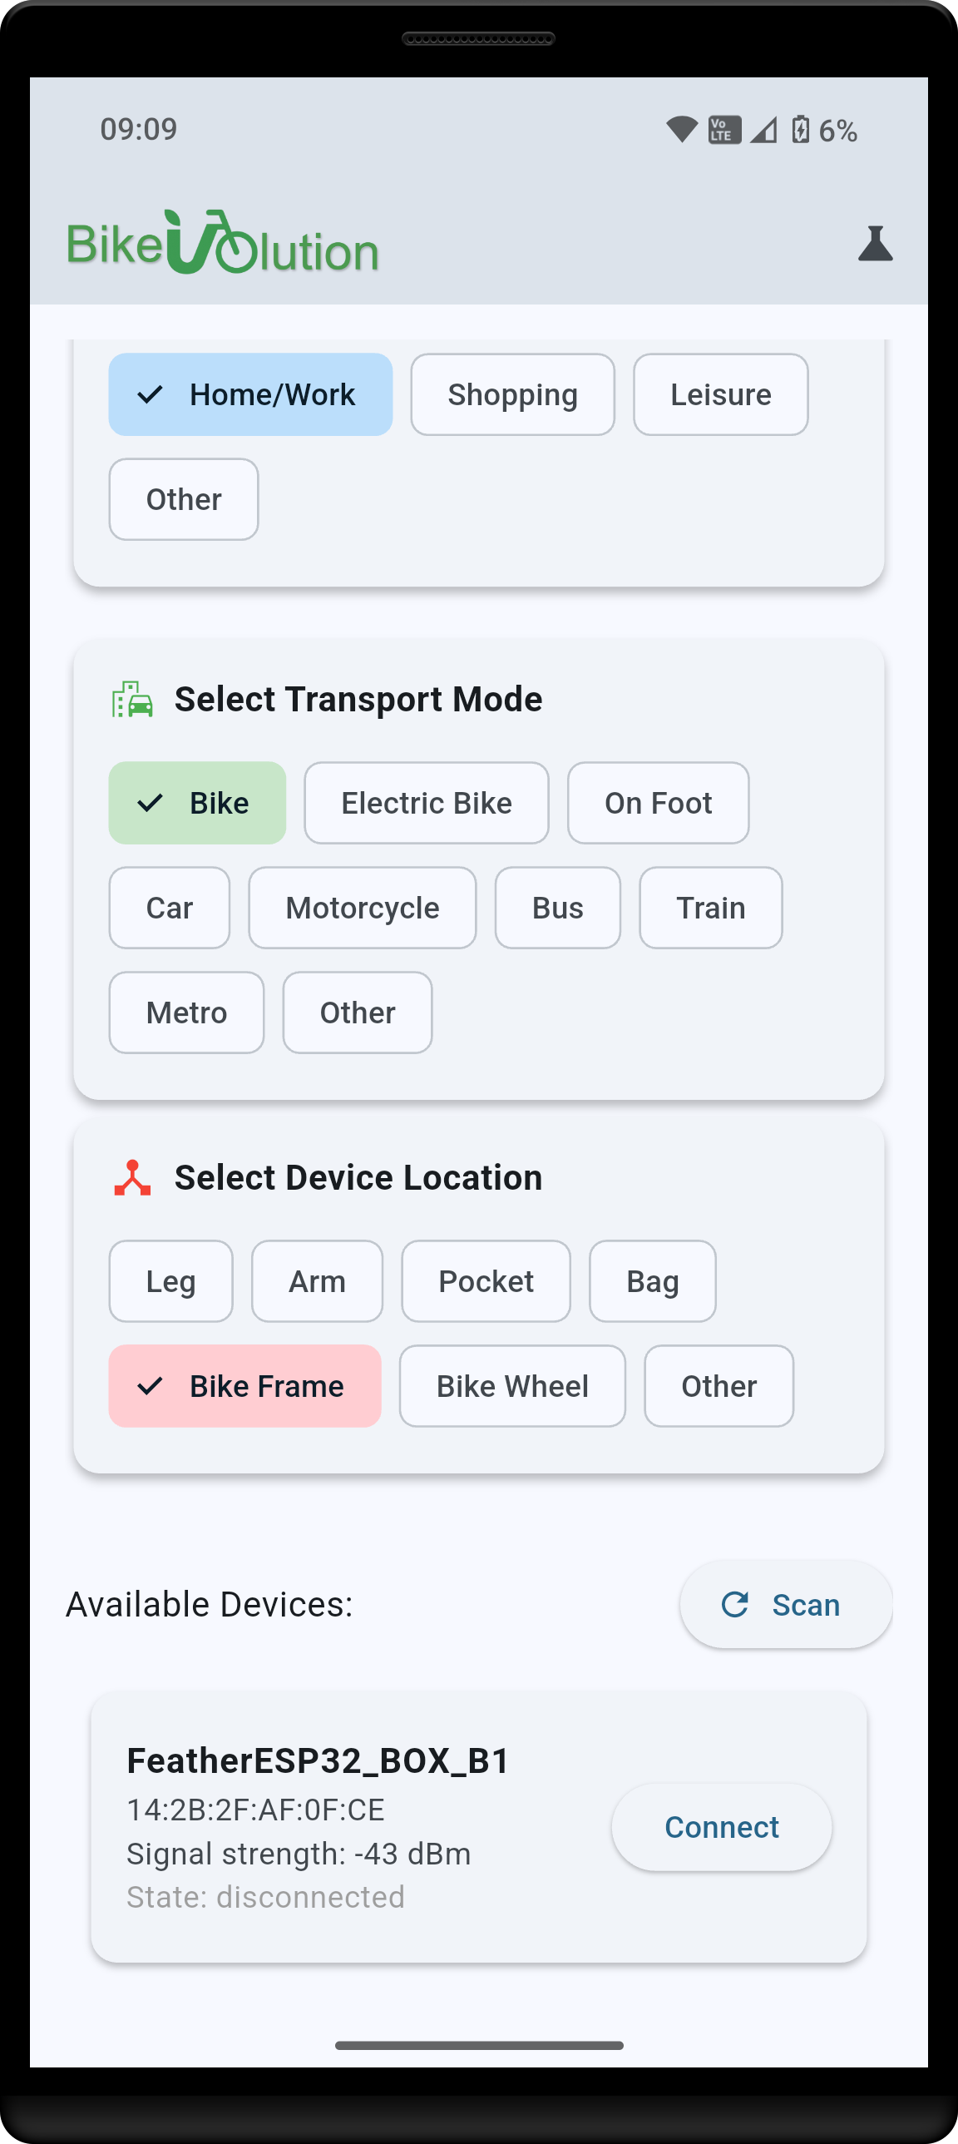


uvolution
Mobility Management
UVolution Green Ltd
founded in 2023 (Lisbon, Portugal)
a spinoff of 12+ years of R&D on Road Transport and Urban Mobility Sustainability
i2D Telematics Research Platform proprietary, supporting a dozen international millionaire R&D projects since 2012
Previous EU recognition
  2015: H2020 SME-I Phase 1 Grant
  2018: H2020 SME-I Phase 2 Seal of Excellence
  2022: EIC GHG Programme participant
  2023: PRR (PT) Bike-UVolution POC (TRL 6)
  2023, April: i2D-MSW project Celtic-Next Full Label (not executed)
Sep 2025
3

Slide 4


uvolution
Mobility Management
Tech Goals | Challenges and required Skills
Universal OBFCM (On Board Fuel Consumption
Monitoring) for cars & vans since 2004, processing free-public raw data
GDPR
5G C-V2X Road Safety Applications
REG.º EU 392 / 631 14-07-2021
Privacy by design
VRU
Vulnerable Road Users​​
GPSdisplay without context
No IDs from driver or vehicle
Connected Things Dynamic IDs
Vehicle-Vehicle
Techonolical skills
security
No driver consent dependence
  Precise Positioning
  EDGE computing
  Communications
  AI / ML
  Security (hacking, encryption, BlockChain, integrity... mandatory certifications)
  IMU advanced analytics
Digital Data Enforcement System
EU Data ACT Compliance
DDES
Electronics
IoT Secuity Compliance
Fraud, tamper-proof Data and Information at source / origin
OBUs
VRU Units
Blackbox type, full equiped; own firmware
Portable Device for Vulnerable Road Users
Vodafone | Oracle Clouds
Driving and Mobility Scoring
Front camera unit + ADAS own firmware
Quality, reliable, secure, public-private accessible Big Data Bases Storage and Analytics
energy efficiency
driving and mobility scores related to
environment
Quantifying, in EUR, real economic impact of Driving-Mobility Scoring Differentials
EU Data ACT
Safety
Road transport costs
accidents
US Cloud ACT
Congestion
Congestion
Sep 2025
4

Slide 5

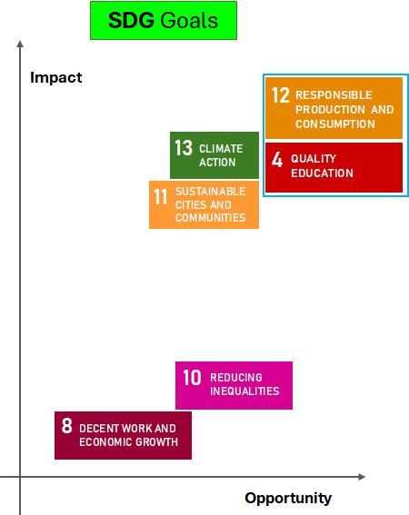
uvolution
Mobility Management
Business & Social goals
Cars, Vans and People Management
Individual vehicles Passenger light vehicles Fleets Commercial light vehicles Fleets | People
support
Insurance Telematics
UBI – Usage Based Insurance CLAIMs efficiency RISK area improvement
Cloud Data Analytics
Real-world consumption of fuel, energy and emissions production of Road Transport sector; Real-world mileage / vehicle
Bike-UVolution
Supporting public & private incentives for each km (€ 0,30) driven by individual car in urban commuting substituted by any sustainable transport
Global Mobility Data and Management of connected People and Vehicles
People and Vehicle own connectivity Rich Mobility characterization (OBFCM, Driving and Mobility Scoring, insurance data…) Road Safety accident’s warning Vodafone partnership Data Analytics
future Road transport ETS - Emissions Trading System
Sep 2025
5

Slide 6
uvolution
Mobility Management
Partners
Project Deadline
18 months
Confirmed | Pending from national fund | Waiting | Looking for
UVolution Green (PT) Vodafone Portugal (PT) IDMEC Lisboa (PT) Cascais Próxima (PT) SPI - Soc. Port. Inovação (PT) Seacon (HUN) | EMS (UK) Brunel University (UK) | Vodafone UK BEIA (ROU) DFKI (DEU) ...?
Miguel Aires
miguel.aires@uvolution.pt
+351 912182080
Subcontracted
  Robust Buton (PT)
  ISQ – Instituto Soldadura e Qualidade (PT)
Supporting Letters
  TML (PT)
  IMT (PT)
  ANSR (PT)
  ?? (HUN)
  ….
Sep 2025
6

